Slide 1

Emotion-Aware Song Analysis & Recommendation System Using Lyrics and Listening Data
Anabel Grabensteiner
(Presentation Video included in Slides)
Github repository link: https://github.com/ankyber/genai

Slide 2
Project Proposal
Objectives & Relevance: This project explores how artificial intelligence can interpret emotional content in song lyrics and user input to provide emotionally aware recommendations. Relevance to Humanities: It bridges music, literature, and digital humanities by applying NLP to understand affect in cultural artifacts.

Slide 3
Key Insights
Transformer models (XLNet/BERT) significantly improve emotion recognition in lyrics compared to traditional methods using acoustic or social tag featuresarxiv.org+1researchgate.net+1.
LyEmoBERT shows ~92% accuracy on emotion-labeled lyrics and demonstrates the effectiveness of combining emotion classification with song recommendationsciencedirect.com.
Deep learning with word embeddings (Bi-LSTM + GloVe/Word2Vec/FastText) highlights the importance of semantic representations in lyric-based emotion classificationaclanthology.org+9sciencedirect.com+9arxiv.org+9. Large-scale lyric analysis reveals trends in emotional tone and bias over time — reinforcing the relevance of lyrical content for cultural and emotional studyreddit.com+3arxiv.org+3thetimes.co.uk+3.

Slide 4
Data Collection
User input (Lyrics or desired song mood)
Small Song Database for suggestions (https://www.kaggle.com/datasets/suraj520/music-dataset-song-information-and-lyrics)

Slide 5
Model Development
Model Type: Fine-tuned distilbert-base-uncased transformer on the dair-ai/emotion dataset for emotion classification. Embedding model: all-MiniLM-L6-v2 used for semantic lyric comparisons. Unique Aspect: Combined emotion-aware classification with vector-based semantic search (FAISS), enabling emotion-aligned song recommendations.

Slide 6
Evaluation
Main Metric
Accuracy and F1 Score were used for emotion classification.
Manual sanity checks and example-based inspection for vector search output.

Slide 7
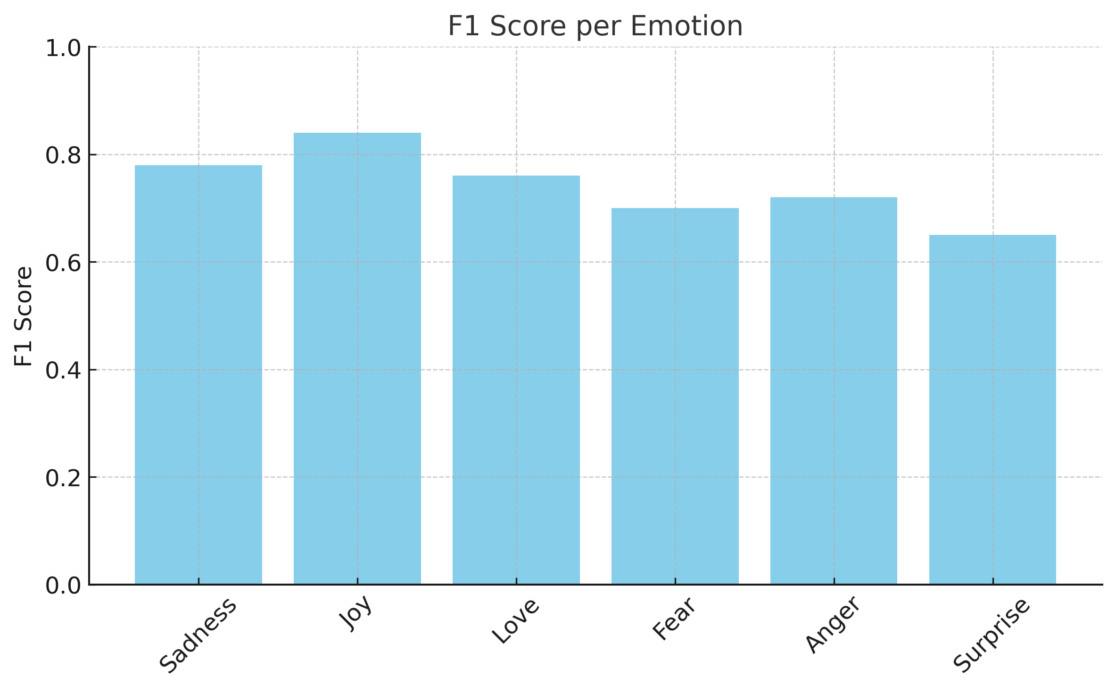
F1 Performance results
Sadness: 0.78
Joy: 0.84
Love: 0.76
Fear: 0.70
Anger: 0.72
Surprise: 0.65

Slide 8
Creative Output
A chatbot that lets users input either a song, favorite lyrics or a mood and returns mood-matched song recommendations based on vector similarity and emotion classification.

Slide 9
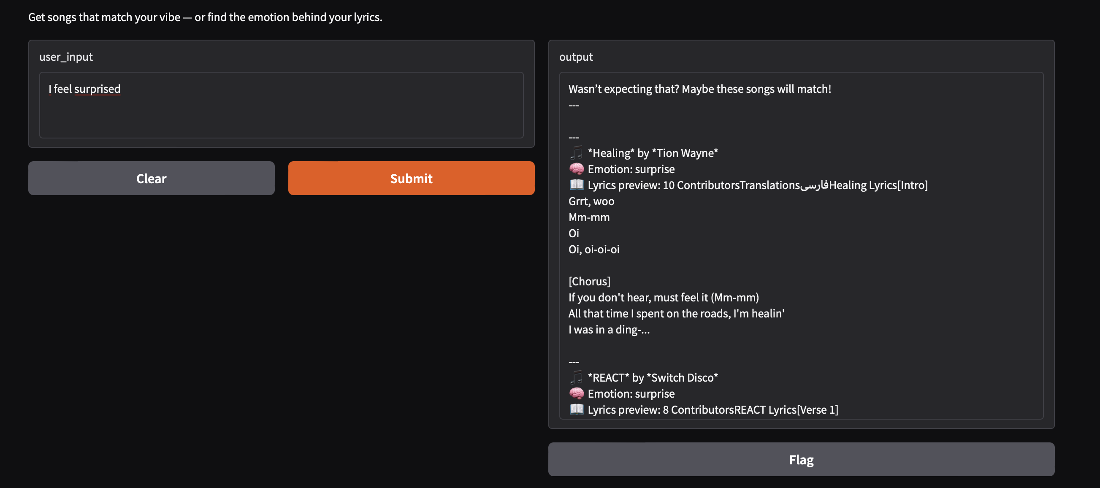

Slide 10
Reflection
Ethical Consideration: How do we handle emotional profiling? Music taste is deeply personal—system must not reinforce bias or stereotype based on mood history.
Future Direction:
Expand emotion taxonomy beyond six categories (e.g., nostalgia, anxiety).
Integrate lyrics generation or emotional songwriting aid.

Slide 11
Conclusion
Impact Summary: This project demonstrates how AI can be used in a culturally sensitive way to understand and support emotional self-expression through music.
Github repository link: https://github.com/ankyber/genai

